Slide 1

JAVA

Slide 2
PROGRAMMING LANGUAGE

Slide 3
Types of languages:
Low level or machine level language --> 0’s, 1’s (binary)
Middle level or assembly language -->
C language
( It also known as the intermediate programming language )
High level language --> human friendly language

Slide 4
HISTORY OF JAVA
The history of Java starts with the Green Team. Java team members (also known as Green Team), initiated this project to develop a language for digital devices such as set-top boxes, televisions, etc.
Firstly, it was called "Green talk" by James Gosling. After that, it was called Oak and was developed as a part of the Green project.
In 1995, Oak was renamed as "Java" because it was already a trademark by Oak Technologies.

Slide 5
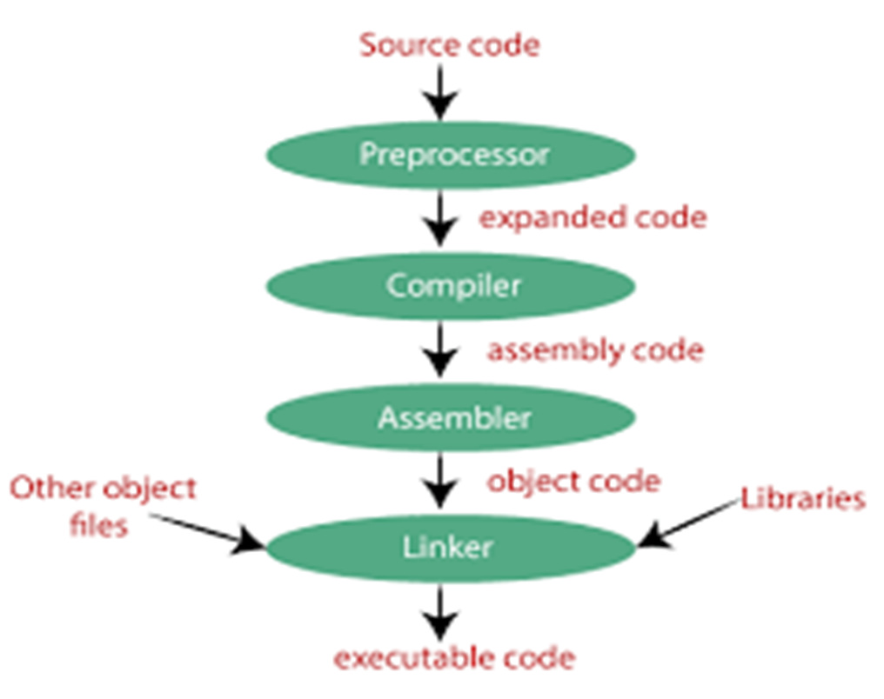
HOW TO GET C FILE EXECUTED

Slide 6
HOW JAVA PROGRAM GET EXECUTED
Source
code
Java
compiler
Byte code in JVM
Java
Interpreter
Mechine code

Slide 7
COMPILER VS INTERPRETER
Compiler | Interpreter
A compiler translate the source program in a single line. | A Interpreter translate the source code in line by line
It is faster | It is slower
It consumes less time | It consumes more time
It is more efficient | It is less efficient
Compilers are large size | Interpreters are smaller than compiler
It creates object code file | It does not creates object code file

Slide 8
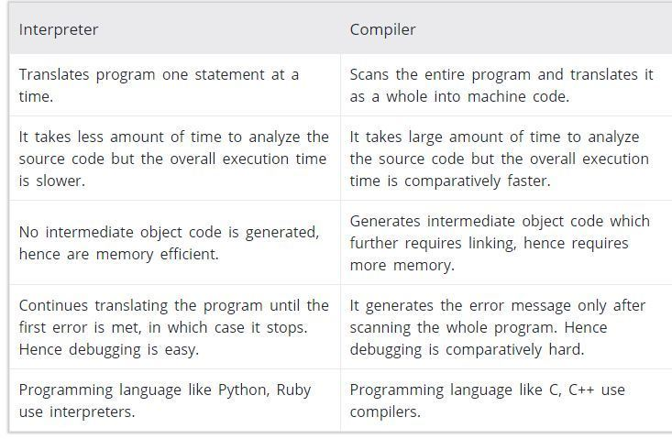

Slide 9
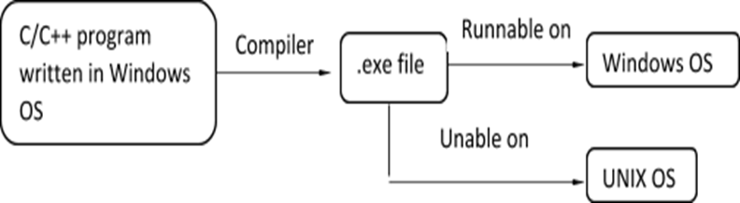
WHY C/C++ PLATFORM DEPENDENT
C/C++ programs are platform dependent.
because,

Slide 10
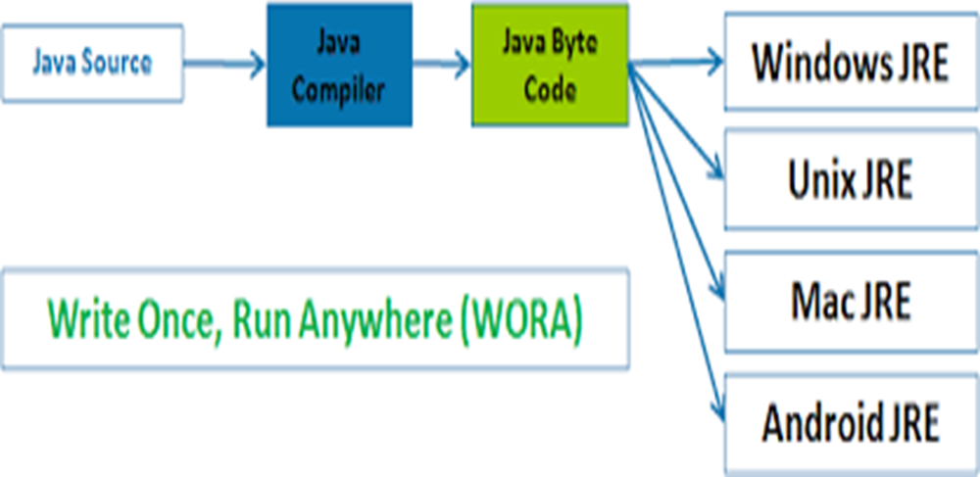
WORA
(Write Once Run Anywhere)

Slide 11
JAVA ARCHITECTURE
Java Architecture is a collection of components, i.e., JVM, JRE, and JDK.
It integrates the process of interpretation and compilation. It defines all the processes involved in creating a Java program.

Slide 12
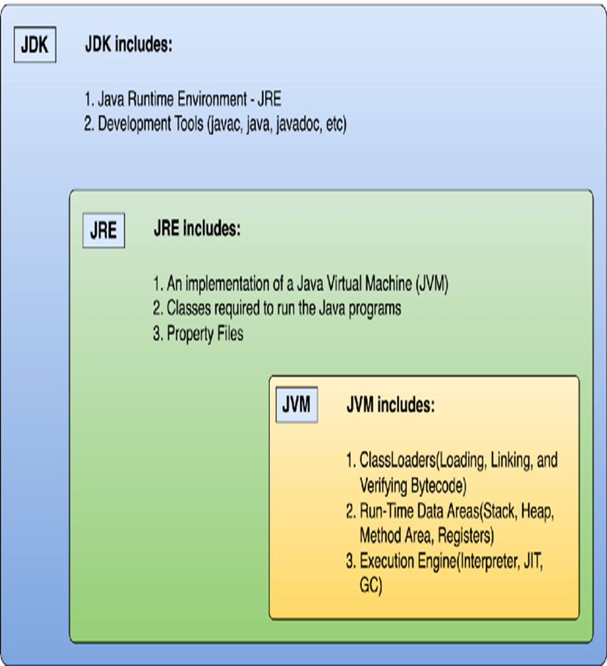

Slide 13
Java Architecture can be explained by using the following steps:
There is a process of compilation and interpretation in Java.
Java compiler converts the Java code into byte code.
After that, the JVM converts the byte code into machine code.
The machine code is then executed by the machine.

Slide 14
Components of Java Architecture
The Java architecture includes the three main components:
Java Virtual Machine (JVM)
Java Runtime Environment (JRE)
Java Development Kit (JDK)

Slide 15
JVM (Java Virtual Machine) Architecture
JVM (Java Virtual Machine) is an abstract machine.
It is a specification that provides runtime environment in which java bytecode can be executed.
JVMs are available for many hardware and software platforms (i.e. JVM is platform dependent).

Slide 16
JVM Architecture
It contains:
A virtual processor
Interpreter: Read bytecode stream then execute the instructions.
Just-In-Time(JIT) compiler

Slide 17
Just-In-Time(JIT) compiler:
It is used to improve the performance.
JIT compiles parts of the byte code that have similar functionality at the same time, and hence reduces the amount of time needed for compilation.
Here, the term "compiler" refers to a translator from the instruction set of a Java virtual machine (JVM) to the instruction set of a specific CPU.

Slide 18
JRE
JRE is an acronym for Java Runtime Environment. It is also written as Java RTE.
The Java Runtime Environment is a set of software tools which are used for developing Java applications. It is used to provide the runtime environment. It is the implementation of JVM.
It physically exists. It contains a set of libraries + other files that JVM uses at runtime

Slide 19
JDK
JDK is an acronym for Java Development Kit.
It contains JRE + development tools.
The JDK contains a private Java Virtual Machine (JVM) and a few other resources such as an interpreter/loader (java), a compiler (javac), an archiver (jar), a documentation generator (Java doc), etc. to complete the development of a Java Application.

Slide 20
APPLICATIONS OF JAVA
Mobile applications (specially Android apps) Desktop applications
Web applications
Enterprise application
Scientific application
Gaming application
Database connection
Business application

Slide 21
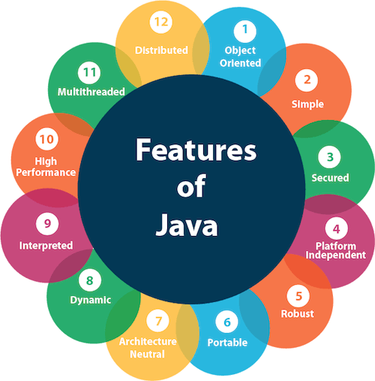
FEATURES OF JAVA

Slide 22
TYPES OF JAVA
Java SE (Java Standard Edition) - It is a Java programming platform.
Java EE (Java Enterprise Edition) - used to develop web and enterprise applications.
Java ME (Java Micro Edition) - used to develop mobile applications.
JavaFX -It is used to develop rich internet applications. It uses a light-weight user interface API(application programming interface).

Slide 23
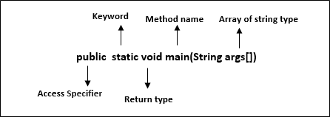
JAVA MAIN() METHOD
The main() is the starting point for JVM to start execution of a Java program.
Without the main() method, JVM will not execute the program. The syntax of the main() method is:

Slide 24
class : keyword is used to declare a class in Java.
public: keyword is an access modifier that represents visibility. It means it is visible to all.
static: Static methods are the method which invokes without creating the objects, so we do not need any object to call the main() method.

Slide 25
void : is the return type of the method. It means it doesn't return any value.
main : represents the starting point of the program.
String[] args or String args[] :It accepts a group of strings, which is called a string array.
It is used to hold the command line arguments in the form of string values.

Slide 26
System.out.println() is used to print statement.
System is a class.
out is an object of the PrintStream class,
println() is a method of the PrintStream class.

Slide 27
Example Program:
class Kokila{
public static void main(String args[]){
System.out.println("Hello Java");
}
}
To compile: javac Kokila.java
To run :java Kokila

Slide 28
FUNDAMENTALS OF JAVA

Slide 29
FUNDAMENTALS OF JAVA
Variables/Identifiers
Keywords
Data types
Operators
Comments

Slide 30
Identifiers or Variables
Variables → to store the value and allocate memory space for that value.
Ex: int a=10;
Syntax
Data-type variable=value;
Identifiers → set of rules and conditions

Slide 31
Do’s
1.lower case → ex: a,..,z or yoga=10
2. uppercase → ex:A,..,Z or YOGA=2
3. Both upper and lower → ex: Yoga=9
4. Underscore (_) yo_ga=1
5. Variable after number → a=10, a1=3

Slide 32
Don’ts
1.Blank/white space not allowed
2. Keywords not allowed if=10
3.Special symbols (!@#%^&*)-+:”<>?*/.,;’[]{}| @=3
4.can’t start with digit ex: 1=10, 2agcd=9

Slide 33
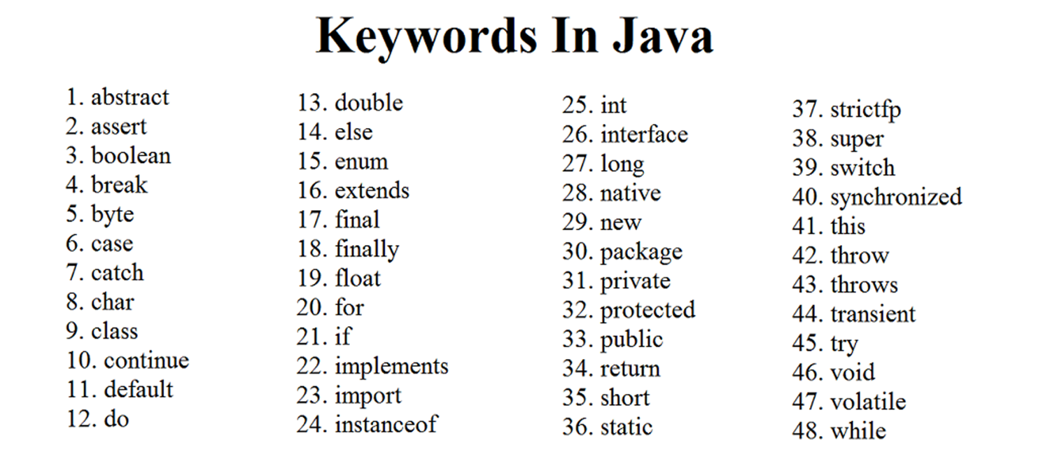
KEYWORDS
Keywords are already reserved words and they have predefined meaning.
Defining the syntax and structure of program.

Slide 34
Data Types in Java
Data types specify the different sizes and values that can be stored in the variable.
There are two types of data types in Java:
Primitive data types: The primitive data types include boolean, char, byte, short, int, long, float and double.
Non-primitive data types: The non-primitive data types include Classes, Interfaces, and Arrays.

Slide 35
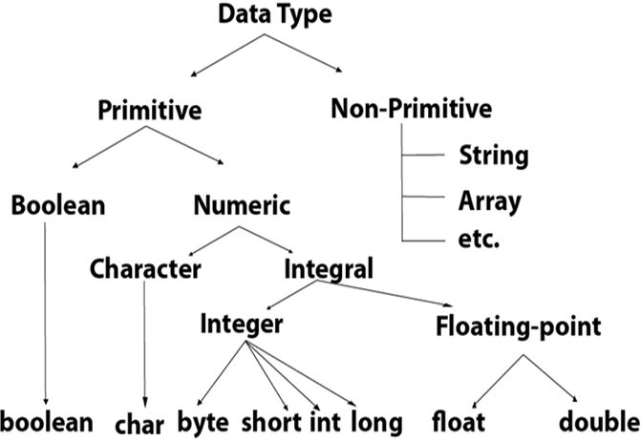
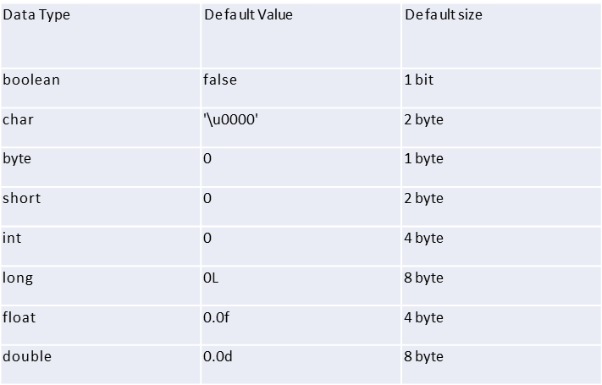
Primitive data types
or standard datatype
boolean data type
byte data type
char data type
short data type
int data type
long data type
float data type
double data type

Slide 36
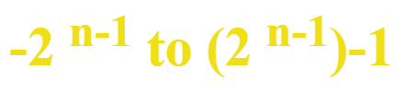
Non-primitive data types:
It is derived data type
Class, object, array, string, and interface are called non-primitive data types in Java.
These data types are not predefined in Java.
They are created by programmers.

Slide 37
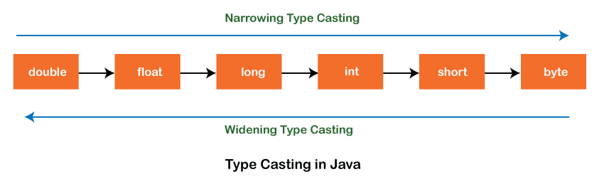
TYPE CASTING
One type of data is getting converted into another type of data.
1.Implicit type casting or widening
2.Explicit type casting or narrowing

Slide 38
TYPES OF COMMENTS
Java Single Line Comment
Single line comments starts with two forward slashes (//). Any text in front of // is not executed by Java.
Java Multi Line Comment
Multi-line comments are placed between /* and */. Any text between /* and */ is not executed by Java.

Slide 39
Operators
Operators are symbols that perform operations on and values.
Operators in Java can be classified into 7 types:
Arithmetic Operators
Assignment Operators
Relational Operators
Logical Operators
Unary Operators
Bitwise Operators
7.Ternary operator

Slide 40
Java Arithmetic Operators
Java arithmetic operators are used to perform addition, subtraction, multiplication, and division.
They act as basic mathematical operations.

Slide 41
Java Arithmetic Operator Example
public class OperatorExample{
public static void main(String args[]){
int a=10;
int b=5;
System.out.println(a+b);//15
System.out.println(a-b);//5
System.out.println(a*b);//50
System.out.println(a/b);//2
System.out.println(a%b);//0
}}

Slide 42
Java Assignment Operator
Java assignment operator is one of the most common operators. It is used to assign the value on its right to the operand on its left.
Java Assignment Operator Example
public class OperatorExample{
public static void main(String args[]){
int a=10;
int b=20;
a+=4;//a=a+4 (a=10+4)
b-=4;//b=b-4 (b=20-4)
System.out.println(a);
System.out.println(b); }}

Slide 43
Relational Operators
Operator | Meaning
== | Is equal to
!= | Is not equal to
> | Greater than
< | Less than
>= | Greater than or equal to
<= | Less than or equal to

Slide 44
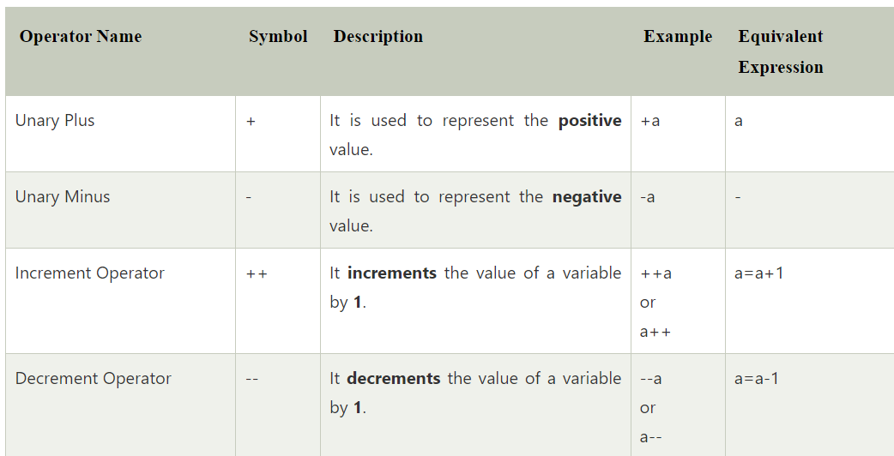
Unary Operators

Slide 45
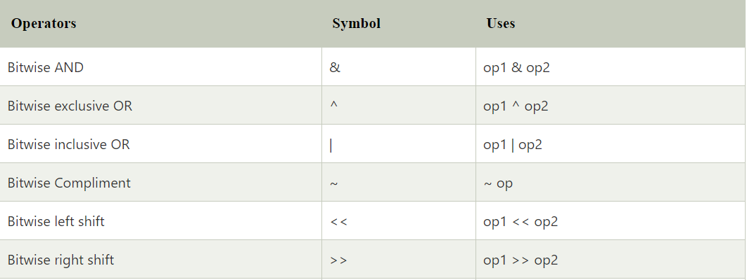
Bitwise Operator

Slide 46
Bitwise AND Bitwise XOR
Bitwise OR Bitwise complement
X | Y | X&Y
0 | 0 | 0
0 | 1 | 0
1 | 0 | 0
1 | 1 | 1
X | Y | X^Y
0 | 0 | 0
0 | 1 | 1
1 | 0 | 1
1 | 1 | 0
X | Y | X|Y
0 | 0 | 0
0 | 1 | 1
1 | 0 | 1
1 | 1 | 1
X | ~X
0 | 1
1 | 0

Slide 47
Shift Operators
Left Shift Operator (<<)
Right Shift Operator (>>)
Left Shift Operator (<<)
The signed left shift operator (<<) shifts a bit pattern to the left. It is represented by the symbol <<.
It also preserves the leftmost bit (sign bit). It does not preserve the sign bit.

Slide 48
Right Shift Operator (>>)
It shifts a zero at the leftmost position and fills 0. It is denoted by the symbol >>>.
the leftmost position after >> depends on the sign bit. It does not preserve the sign bit.

Slide 49
Logical operators
Logical operators are generally used for combining two or more relational statements. They return Boolean values.
&& (Logical AND)
The logical && operator doesn't check the second condition if first condition is false. It checks the second condition only if the first one is true.

Slide 50
|| (Logical OR)
The Logical OR operator is represented with the two vertical line symbols.
It works opposite to the logical AND operator, as it only gives false when both statements of the expression are not true. Otherwise, it returns true.

Slide 51
! (Logical NOT operator)
This logical operator is represented as an exclamation sign (!). This operator accepts a single argument and returns the inverse value of the corresponding argument.

Slide 52
Ternary Operator
In Java, the ternary operator is a type of Java conditional operator.
The meaning of ternary is composed of three parts.
The ternary operator (? :) consists of three operands.
It is used to evaluate Boolean expressions.
Syntax:
variable = (condition) ? expression1 : expression2

Slide 53
Control statements

Slide 54
Flow of control
Sequential statements
Selectional/Conditional statements
Loop/Iterative/Repeation statements
Jumping/transfer statements

Slide 55
Control statements
It controls the flow of a program.
A control statement in java is a statement
that determines whether the other statements will be executed or not.

Slide 56
If statement
if statement to specify a block of Java code to be executed if a condition is true.
Syntax:
if (condition) {
// block of code to be executed if the condition is true }
Real time Example:
If there is raining , we will not play in the ground

Slide 57
If else statement
else statement to specify a block of code to be executed if the condition is false.
Syntax:
if (condition) {
// block of code to be executed if the condition is true}
else {
// block of code to be executed if the condition is false
}
Real time Example
If there is raining . we will not play in the ground,else
We will play in the ground.

Slide 58
Else if statement
else if statement to specify a new condition if the first condition is false.
Syntax:
if (condition1) {
// block of code to be executed if condition1 is true } else if (condition2) {
// block of code to be executed if the condition1 is false and condition2 is true }
else {
// block of code to be executed if the condition1 is false and condition2 is false }
Real time Example:
Student mark system , Income tax payment.

Slide 59
Nested if statement
The nested if statement represents the if block within another if block.
Here, the inner if block condition executes only when outer if block condition is true.
Syntax:
if(condition){
//code to be executed
if(condition){
//code to be executed
} }
Real Time Example:
Blood Donation conditions.

Slide 60
switch statement
The Java switch statement executes one statement from multiple conditions. It is like if-else-if ladder statement.
Syntax
switch(expression){
case value1:
//code to be executed;
break; //optional
default:
code to be executed if all cases are not matched; }

Slide 61
Loop/Iterative/Repeatation statements
Loops is used to execute a particular part of the
program repeatedly , if a given condition evaluates to be true.
For example,
You put your favorite song on a repeat mode. It is also a loop.
Software of the ATM machine is in a loop to process transaction after
transaction until you acknowledge that you have no more to do.

Slide 62
Types of loops
There are three types of loop
for loop\Entry check loop
While loop\Entry check loop
Do while loop\Exist check loop

Slide 63
for Loop
A simple for loop is the same as C/C++. We can initialize the variable, check condition and increment/decrement value.
Syntax:
for(initialization; condition; increment/decrement)
{
//statement or code to be executed
}

Slide 64
for loop have 5 types
for loop using increment
for loop using decrement
for loop using infinity
Nested for loop
for each/for enhanced loop

Slide 65
While Loop
The Java while loop is used to iterate a part of the program repeatedly until the specified Boolean condition is true. As soon as the Boolean condition becomes false, the loop automatically stops.
Syntax
while (condition){
//code to be executed
Increment / decrement statement
}

Slide 66
Types of While loop
While loop using Increment
While loop using decrement
Infinity while loop

Slide 67
do-while Loop
If the number of iteration is not fixed and you must have to execute the loop at least once, it is recommended to use a do-while loop.
Syntax:
do
{
//code to be executed / loop body
//update statement
}while (condition);

Slide 68
Transfer or Jumping Statements
Jumping statements are control statements that transfer execution control from one point to another point in the program.
There are two Jump statements that are provided in the Java programming language:
break statement.
continue statement.

Slide 69
Break Statement
The Java break statement is used to break loop or switch statement. It breaks the current flow of the program at specified condition.
In case of inner loop, it breaks only inner loop.
Syntax:
jump-statement;
break;

Slide 70
Continue Statement
The Java continue statement is used to continue the loop.
It continues the current flow of the program and skips the remaining code at the specified condition.
In case of an inner loop, it continues the inner loop only.
Syntax:
jump-statement;
continue;

Slide 71
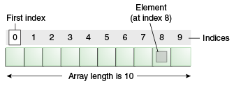
ARRAY
An array is a container object that holds a fixed number of values of a single type. The length of an array is established when the array is created. After creation, its length is fixed.
Real time Example:
Mobile number saving.
Show room.

Slide 72
Advantages
Code Optimization: It makes the code optimized, we can retrieve or sort the data efficiently.
Random access: We can get any data located at an index position.
Disadvantages
Size Limit: We can store only the fixed size of elements in the array. It doesn't grow its size at runtime.

Slide 73
Types of Array in java
There are two types of array.
Single Dimensional Array
Multidimensional Array
Syntax to Declare an Array in Java
dataType[] arr; (or)
dataType arr[];
Datatype arrayname[ ]=new datatype[size ];

Slide 74
Single dimensional array
class Testarray{
public static void main(String args[]){
int a[]=new int[5];
a[0]=10;//initialization
a[1]=20;
a[2]=70;
for(int i=0;i<a.length;i++)
System.out.println(a[i]);
}}

Slide 75
Multidimensional Array
class Testarray3{
public static void main(String args[]){
int arr[][]={{1,2,3},{2,4,5},{4,4,5}};
//printing 2D array
for(int i=0;i<3;i++){
for(int j=0;j<3;j++){
System.out.print(arr[i][j]+" "); }
System.out.println();
} }}

Slide 76
Functions in Java
OR
Methods in java

Slide 77
What is Functions?
The function or method is a collection of instructions that performs a specific task.
You can pass data, known as parameters, into a method.
Function is a block of code which runs only it is called .
Real time Example:
Switch have two functions ,that is on() and off().

Slide 78
Why Functions?
It provides the reusability of code.
It also provides the easy modification and readability of code, , just by adding or removing a chunk of code.
Function are useful in hiding the implementation details.
It is easier to edit a program, which is written using methods

Slide 79
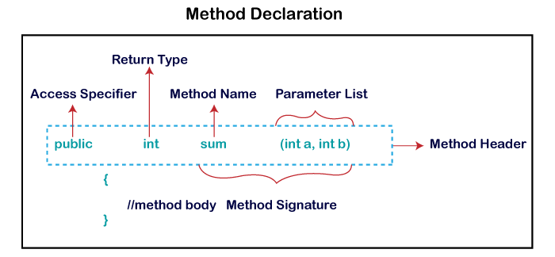
Syntax for Function

Slide 80
Types of Functions
There are Four types of methods in Java:
Predefined Method
User-defined Method
Return Method
Recursive Method

Slide 81
Predefined Method
The method that is already defined in the Java class libraries is known as predefined methods.
It is also known as the standard library method or built-in method.
Some pre-defined methods are length(), equals(), compareTo(), sqrt(), etc.

Slide 82
User-defined Method
The method written by the user or programmer is known as a user-defined method.
These methods are modified according to the requirement.
It is 4 types
Function with argument , with return value.
Function with argument , without return value.
Function without argument , with return value.
Function without argument , without return value.

Slide 83
Simple Example for Creating and invoking the function
public class Operation
{
public void sum()//Function Creation
{
int a=10,b=20;
int sum=a+b;
System.out.println(“The sum is “+sum);
}
public static void main(String[] args)
{
Operation op=new Operation();//Object creation
op.sum();//Function call
}}

Slide 84
Recursion in Java
Recursion in java is a process in which a method calls itself continuously.
A method in java that calls itself is called recursive method.
Syntax:
Return type method name(){
Method name();//calling same method
}

Slide 85
Example Program To find factorial of given number.
public class RecursionExample3 {
static int factorial(int n){
if (n == 1)
return 1;
else
return(n * factorial(n-1));
}
public static void main(String[] args) {
System.out.println("Factorial of 5 is: "+factorial(5));
}
}

Slide 86
STRINGS IN JAVA

Slide 87
Strings
String is a sequence of characters. But in Java, string is an object that represents a sequence of characters. The java.lang.String class is used to create a string object.
For example:

Slide 88
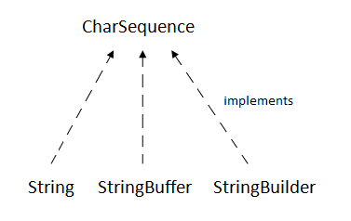
The java.lang.String class implements Serializable, Comparable and CharSequence interfaces.
CharSequence Interface

Slide 89
String pool
String pool is a pool of string which is stored in javas heap memory.
String pool is possible only because strings are immutable
Once it created it can’t be change
String
String is immutable.
Multiple thread can access the same string
since its immutable . Thread safe.

Slide 90
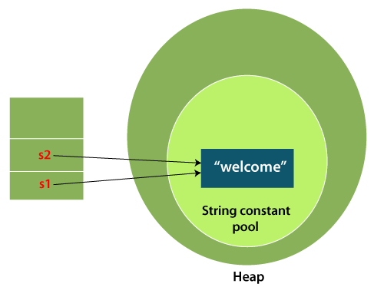
How to create a string object?
There are two ways to create String object:
By string literal
By new keyword
1) String Literal
Java String literal is created by using double quotes.
For Example:
String s="welcome";
String s2=“welcome";

Slide 91
2.By new keyword
String s=new String("Welcome");
In such case, JVM will create a new string object in normal (non-pool) heap memory.
The literal "Welcome" will be placed in the string constant pool.
The variable s will refer to the object in a heap (non-pool).

Slide 92
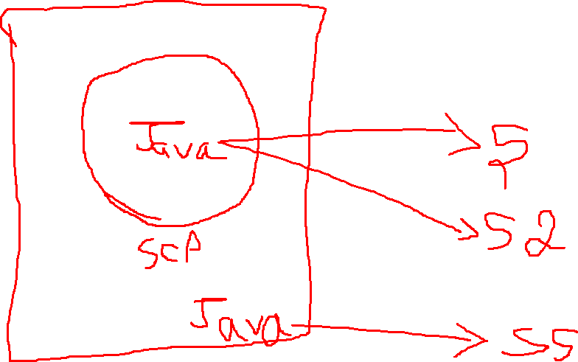

Slide 93
String s=new String("WELCOME");
System.out.println(s.charAt(0));
System.out.println(s.codePointAt(1));
System.out.println(s.codePointBefore(1));
System.out.println(s.compareTo(s));
System.out.println(s.compareToIgnoreCase("kokila"));
System.out.println(s.concat(" kokila"));
System.out.println(s.contains("k"));
System.out.println(s.contentEquals("WELCOMe"));
System.out.println(s.endsWith("E"));
System.out.println(s.contentEquals("Welcome"));
System.out.println(s.equalsIgnoreCase("kokila"));
System.out.println(s.formatted(args));
System.out.println(s.hashCode());
System.out.println(s.indent(5));
System.out.println(s.indexOf("O"));
System.out.println(s.equalsIgnoreCase("welcome"));

Slide 94
System.out.println(s.indexOf("L", 2));
System.out.println(s.intern());
System.out.println(s.isBlank());
System.out.println(s.isEmpty());
System.out.println(s.lastIndexOf("E"));
System.out.println(s.length());
System.out.println(s.replace('W', 'O'));
System.out.println(s.toCharArray());
System.out.println(s.toLowerCase());
System.out.println(s.toUpperCase());
System.out.println(s.startsWith("k"));
System.out.println(s.substring(2));
System.out.println(s.substring(0, 5));
System.out.println(s.valueOf(0));
System.out.println(s);

Slide 95
String buffer class
Java String buffer is used to create mutable string.
Memory allocated to a string is not fixed , it can change.
It is synchronous in nature .thread safe
StringBuffer s=new StringBuffer(“live wire”);

Slide 96
StringBuffer a=new StringBuffer("hello");
a.append("hi");
System.out.println(a);
System.out.println(a.length());
System.out.println(a.capacity());
System.out.println(a);
a.ensureCapacity(22);
System.out.println(a.capacity());
System.out.println(a.deleteCharAt(0));
System.out.println(a.insert(0, 'k'));
System.out.println(a.delete(0, 3));
System.out.println(a.replace(0, 2, "kokila"));

Slide 97
System.out.println(a.substring(0, 3));
System.out.println(a.substring(5));
a.setCharAt(0, 'r');
System.out.println(a);
a.setLength(15);
System.out.println(a.length());
System.out.println(a);
System.out.println(a.reverse());
System.out.println(a);

Slide 98
String Builder
The java stringBuilder class is used to create mutable string.
But, String builder class is non synchronized i.e.it is not thread safe.
Therefore string builder is faster than string buffer.
StringBuilder s=new StringBuilder(“java”);

Slide 99
StringBuilder s=new StringBuilder("kokila");
System.out.println(s);
System.out.println(s.capacity());
s.ensureCapacity(23);
System.out.println(s.capacity());
System.out.println(s.insert(0, 'K'));
System.out.println(s.replace(0, 0, "kokila"));
System.out.println(s.delete(0, 6));
s.setCharAt(0, 'J');
s.setLength(20);
System.out.println(s.length());
System.out.println(s.reverse());
System.out.println(s);

Slide 100
When to use string buffer and string builder
String buffer
String buffer can be accessed by multiple threads at a time.
Slower as compared to string builder.
String builder
String builder can be accessed by a single thread at a time.
Faster than sting buffer.

Slide 101
oops
Object Oriented Programming Structure

Slide 102
What is OOP?
OOP stands for Object-Oriented Programming.
Object-oriented programming is about creating objects that contain both data and methods.
It is created in MIT AI lab in 1960’s.
To develop secured applications.
It is fast and efficient.
Oops used to reduce complexity of code (reduced)

Slide 103
Oops vs pops
Feature | OOPS | POPS
Full form | Object-Oriented Programming System | Procedure-Oriented Programming System
Focus | Objects (data + methods) | Procedures/functions
Approach | Bottom-up | Top-down
Data security | High (data hiding using encapsulation) | Lower (data is often globally accessible)
Reusability | High (inheritance, polymorphism) | Limited (functions can be reused, but no inheritance)
Code organization | Divided into classes and objects | Divided into functions
Maintenance | Easier for large, complex programs | Better suited for small programs
Examples | Java, C++, Python (supports OOP) | C, Pascal

Slide 104
Advantages of Oops
OOP is faster and easier to execute
OOP provides a clear structure for the programs
OOP helps to keep the Java code DRY "Don't Repeat Yourself", and makes the code easier to maintain, modify and debug
OOP makes it possible to create full reusable applications with less code and shorter development time

Slide 105
A few of the procedural languages that are not object-oriented languages are:
FORTRAN
ALGOL
COBOL
BASIC
PASCAL
C
Ada

Slide 106
Oops concepts
Class
Object
Inheritance
Polymorphism
Abstraction
Encapsulation

Slide 107
CLASS
It is an imaginary thing or blue print or template
which contains set of attributes and member functions
Everything in Java is associated with classes and objects, along with its attributes and methods.
For example: in real life, a car is an object. The car has attributes, such as weight and color, and methods, such as drive and break.
syntax:
class classname
{
//statements
}

Slide 108
OBJECT
It a real wolrd thing, for a single class we can create multiple or "n"
number of objects
object contains attributes and member function
class-->animal
object-->dog
variables-->name,color,breed
function-->barking,sleeping,eating
Object syntax
Classname obj=new classname();

Slide 109
INHERITANCE
mainly used to minimize the code
parent child relationship
child class/derived class/subclass-->a class inherits the properties
parent class/base class-->a class whose properties inherited
subclass (child) - the class that inherits from another class
superclass (parent) - the class being inherited from
the extends keyword

Slide 110
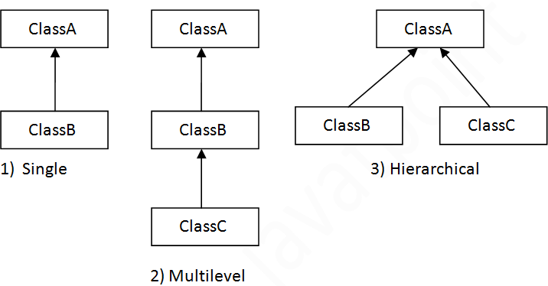
Types of Inheritance

Slide 111
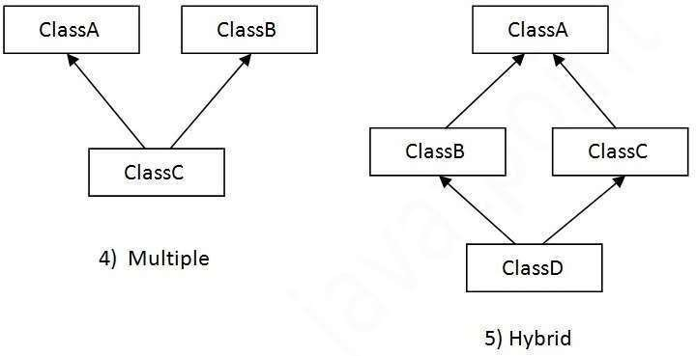

Slide 112
Constructor
A constructor is a block of codes similar to the method.
It is called when an instance of the class is created.
At the time of calling constructor, memory for the object is allocated in the memory.
It is a special type of method which is used to initialize the object.
Every time an object is created using the new() keyword, at least one constructor is called.

Slide 113
Polymorphism
Polymorphism in Java is a concept by which we can perform a single action in different ways.
Polymorphism is derived from 2 Greek words: poly and morphs.
The word "poly" means many and "morphs" means forms. So polymorphism means many forms.
There are three types of polymorphism in Java:
compile-time polymorphism/ method overloading.
runtime polymorphism/method overriding.
Operator overloading-not support in java

Slide 114
Runtime Polymorphism
Example
class Bike{
void run(){System.out.println("running");} }
class Splendor extends Bike{
void run(){System.out.println("running safely with 60km");}
public static void main(String args[]){
Bike b = new Splendor();//upcasting
b.run();
} }

Slide 115
Compile time Polymorphism
class Shapes {
public void area()
{ System.out.println("Find area "); }
public void area(int r)
{ System.out.println("Circle area = "+3.14*r*r); }}
class Main {
public static void main(String[] args) {
Shapes myShape = new Shapes();
myShape.area();
myShape.area(5);}}

Slide 116
Super keyword
It is a reference variable that is used to refer parent class objects.
parent class instance variable.

Slide 117
Example
class Animal{
String color="white";
}
class Dog extends Animal{
String color="black";
void printColor(){
System.out.println(color);//prints color of Dog class
System.out.println(super.color);//prints color of Animal class
} }
class TestSuper1{
public static void main(String args[]){
Dog d=new Dog();
d.printColor(); }}

Slide 118
This keyword
In Java, this is a reference variable
that refers to the current object.
Invoke current class constructor
Invoke current class method
Return the current class object
Pass an argument in the method call
Pass an argument in the constructor call

Slide 119
Example
class Student{
int rollno;
String name;
float fee;
Student(int rollno,String name,float fee){
this.rollno=rollno;
this.name=name;
this.fee=fee; }
void display(){System.out.println(rollno+" "+name+" "+fee);} }
class TestThis2{
public static void main(String args[]){
Student s1=new Student(111,"ankit",5000f);
Student s2=new Student(112,"sumit",6000f);
s1.display(); s2.display(); }}

Slide 120
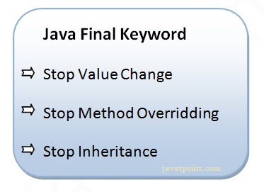
Final keyword
If you make any variable as final, you cannot change the value of final variable(It will be constant).

Slide 121
Abstraction
Hiding internal details and showing functionality is known as abstraction. For example phone call, we don't know the internal processing.
In Java, we use abstract class and interface to achieve abstraction.
There are two ways to achieve abstraction in java
Abstract class(0 to 100% abstraction)
Interface(100% abstraction)

Slide 122
Example of Abstract class that has an abstract method
In this example, Bike is an abstract class that contains only one abstract method run. Its implementation is provided by the Honda class.
abstract class Bike{
abstract void run();
}
class Honda4 extends Bike{
void run(){System.out.println("running safely");}
public static void main(String args[]){
Bike obj = new Honda4();
obj.run();
}
}

Slide 123
Interface
The interface in Java is a mechanism to achieve abstraction.
There can be only abstract methods in the Java interface, not method body.
Uses of interface:
It is used to achieve abstraction.
By interface, we can support the functionality of multiple inheritance.

Slide 124
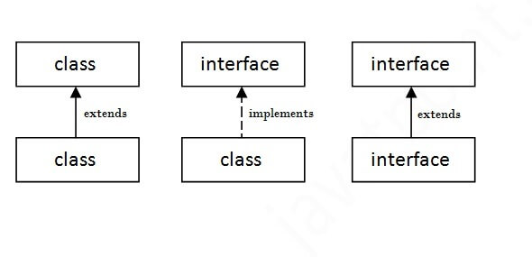

Slide 125
Java Interface Example
In this example, the Printable interface has only one method, and its implementation is provided in the A6 class.
interface printable{
void print(); }
class A6 implements printable{
public void print(){System.out.println("Hello");}
public static void main(String args[]){
A6 obj = new A6();
obj.print(); } }

Slide 126
Encapsulation
Encapsulation in Java is a process of wrapping code and data together into a single unit, for example, a capsule which is mixed of several medicines.
We can create a fully encapsulated class in Java by making all the data members of the class private.
Now we can use setter and getter methods to set and get the data in it.
The Java Bean class is the example of a fully encapsulated class.

Slide 127
Advantage of Encapsulation in Java
By providing only a setter or getter method, you can make the class read-only or write-only.
It is a way to achieve data hiding in Java because other class will not be able to access the data through the private data members.
The encapsulate class is easy to test. So, it is better for unit testing.

Slide 128
Simple Example of Encapsulation in Java
Let's see the simple example of encapsulation that has only one field with its setter and getter methods.
class Account {
private long acc_no;
private String name;
public long getAcc_no() { return acc_no; }
public void setAcc_no(long acc_no) { this.acc_no = acc_no; }
public String getName() { return name; }
public void setName(String name) { this.name = name; }
public class TestEncapsulation {
public static void main(String[] args) {
acc.setAcc_no(7560504000L);
acc.setName("Sonoo Jaiswal");
system.out.println(acc.getAcc_no()+" "+acc.getName());}}

Slide 129
Static Binding and Dynamic Binding
Connecting a method call to the method body is known as binding.
There are two types of binding
Static Binding (also known as Early Binding).
Dynamic Binding (also known as Late Binding).

Slide 130
Static binding
When type of the object is determined at compiled time(by the compiler), it is known as static binding.
If there is any private, final or static method in a class, there is static binding.

Slide 131
Example of static binding
class Dog{
private void eat(){System.out.println("dog is eating...");}
public static void main(String args[]){
Dog d1=new Dog();
d1.eat();
}
}

Slide 132
Dynamic binding
When type of the object is determined at run-time, it is known as dynamic binding.

Slide 133
Example of dynamic binding
class Animal{
void eat(){System.out.println("animal is eating...");}
}
class Dog extends Animal{
void eat(){System.out.println("dog is eating...");}
public static void main(String args[]){
Animal a=new Dog();
a.eat(); } }

Slide 134
Heap Memory and Stack Memory

Slide 135
Java Memory Management
In Java, Memory Management is a vital process. It is managed by Java automatically.
The JVM divides the memory into two parts: Stack memory and Heap memory.
From the perspective of Java, both are important memory areas but both are used for different purposes.

Slide 136
The major difference between Stack memory and heap memory is that the stack is used to store the order of method execution and local variables.
while the heap memory stores the objects and it uses dynamic memory allocation and deallocation.

Slide 137
Stack Memory
The stack memory is a physical space (in RAM) allocated to each thread at run time. It is created when a thread creates.
Memory management in the stack follows LIFO (Last-In-First-Out) order because it is accessible globally.
It stores the variables, references to objects, and partial results.
Memory allocated to stack lives until the function returns.
If there is no space for creating the new objects, it throws the java.lang.StackOverFlowError.

Slide 138
Heap Memory
It is created when the JVM starts up and used by the application as long as the application runs.
It stores objects and JRE classes. Whenever we create objects it occupies space in the heap memory while the reference of that object creates in the stack.
It does not follow any order like the stack. It dynamically handles the memory blocks. It means, we need not to handle the memory manually.

Slide 139
For managing the memory automatically, Java provides the garbage Collector that deletes the objects which are no longer being used.
Memory allocated to heap lives until any one event, either program terminated or memory free does not occur.
If the heap space is full, it throws the java.lang.OutOfMemoryError.

Slide 140
Access Modifiers
The access modifiers in Java specifies the accessibility or scope of a field, method, constructor, or class.
Private: The access level of a private modifier is only within the class. It cannot be accessed from outside the class.
Default: The access level of a default modifier is only within the package. It cannot be accessed from outside the package.

Slide 141
Public: The access level of a public modifier is everywhere. It can be accessed from within the class, outside the class, within the package and outside the package.
Protected: The access level of a protected modifier is within the package and outside the package through child class. If you do not make the child class, it cannot be accessed from outside the package.

Slide 142
Non-Access modifiers
final -we can use class, variable, method ,object.
static-we can use class, variable ,method ,object.
abstract - we can use class, variable, method.
Synchronized -it is used in threads

Slide 143
Java Package
A java package is a group of similar types of classes, interfaces and sub-packages.
Package in java can be categorized in two form, built-in package and user-defined package.
There are many built-in packages such as java, lang, awt, javax, swing, net, io, util, sql etc.

Slide 144
Advantage of Java Package
1) Java package is used to categorize the classes and interfaces so that they can be easily maintained.
2) Java package provides access protection.
3) Java package removes naming collision.

Slide 145
How to access package from another package?
There are three ways to access the package from outside the package.
import package.*;
import package.classname;
fully qualified name.

Slide 146
1) Using packagename.*
If you use package.* then all the classes and interfaces of this package will be accessible but not subpackages.
The import keyword is used to make the classes and interface of another package accessible to the current package.

Slide 147
Example of package that import the packagename.*
package pack;
public class A{
public void msg(){System.out.println("Hello");}
}
package mypack;
import pack.*;
class B{
public static void main(String args[]){
A obj = new A();
obj.msg(); } }

Slide 148
2) Using packagename.classname
If you import package.classname then only declared class of this package will be accessible.
Example of package by import package.classname
package pack;
public class A{
public void msg(){System.out.println("Hello");}
}

Slide 149
package mypack;
import pack.A;
class B{
public static void main(String args[]){
A obj = new A();
obj.msg();
}
}

Slide 150
3) Using fully qualified name
If you use fully qualified name then only declared class of this package will be accessible.
Now there is no need to import.
But you need to use fully qualified name every time when you are accessing the class or interface.

Slide 151
Example of package by import fully qualified name
package pack;
public class A{
public void msg(){System.out.println("Hello");}
}
package mypack;
class B{
public static void main(String args[]){
pack.A obj = new pack.A();//using fully qualified name
obj.msg();
}
}

Slide 152
Exception Handling
The Exception Handling in Java is one of the powerful mechanism
to handle the runtime errors so that the normal flow of the
application can be maintained.
Exception is an abnormal condition.
Exception Handling is a mechanism to handle runtime errors such as
ClassNotFoundException, IOException, SQLException, RemoteException,etc.

Slide 153
Exception:
Predictable
It can be of checked or unchecked
Can happen at compiletime& runtime
Caused by application
Exception handling
Exception handling is a mechanism to handle errors in the
runtime.
So that the normal flow of the application is maintained.

Slide 154
Types of exceptions
Built in exceptions:
ArithmeticException
ArrayIndexOutofBoundsException
ClassNotfoundException
IoException
StringIndexOutofBoundsException

Slide 155
Advantage of Exception Handling
The core advantage of exception handling is to maintain the normal
flow of the application.
Java Exception Keywords
try
catch
finally
throw
throws

Slide 156
Java Exception Handling Example
public class JavaExceptionExample{
public static void main(String args[]){
try{
int data=100/0;
}catch(Exception e)
{System.out.println(e);}
//rest code of the program
System.out.println("rest of the code...");
}}

Slide 157
File handling in java
IO streams

Slide 158
What is file?
Collection of information or data.
Types of files
.zip
.txt
.pdf
.java
.exe
.c
.pptx

Slide 159
Predefined function
open()
Build in Function
read()
write()
append()

Slide 160
File Operations in Java
File Operations
We can perform the following operation on a file:
Create a File -File(),createNewFile()
Get File Information
Write to a File -FileWriter(),write(),flush(),close()
Read from a File -Scanner(),while loop,hasnext()
Append a file -append()
Delete a File -delete()

Slide 161
Create a File
We use the createNewFile() method of file.
The createNewFile() method returns true when it successfully creates a new file and returns false when the file already exists.

Slide 162
Get File Information
We get the name of the file using the getName()
We get the absolute path of the file using the getAbsolutePath() method of the file.
We check whether we can write data into a file or not using the canWrite()
We check whether we can read the data of the file or not using the canRead()
We get the length of the file by using the length()

Slide 163
Write to a File
In order to write data into a file, we will use the FileWriter class and its write() method together.
Using flush() to write contents into the file.
We need to close the stream using the close() method to retrieve the allocated resources.

Slide 164
Read from a File
Using the file FileReader() to read the file.
In order to write data into a file, we will use the Scanner class. Here, we need to close the stream using the close() method.
We will create an instance of the Scanner class and use the hashNextLine()method nextLine() method to get data from the file.

Slide 165
Append a file
append()
The file is already created and we add to some contents to the file ,we are using the append() function.

Slide 166
Delete a File
In order to delete a file, we will use the delete() method of the file.
We don't need to close the stream using the close() method because for deleting a file, we neither use the FileWriter class nor the Scanner class.

Slide 167
Util Packages
Collections in Java

Slide 168
Collections in java
architecture to store and manipulate the group of objects.
the operations that you perform on searching, sorting, insertion, manipulation, and deletion.
Java Collection means a single unit of objects
The java.util package contains all the classes and interfaces for the Collection framework.

Slide 169
Advantages of collections
Reduces programming effort
Reusability and Interoperability
Increases performance
Increases program speed and quality

Slide 170
Hierarchy of Collection Framework
COLLECTIONS
LIST
QUEUE
SET
MAP
STACK

Slide 171
List in Java
A list interface is an ordered collection of objects in which duplicate values can be stored.
Since a List preserves the insertion order, it allows positional access and insertion of elements.
Types of Lists
ArrayList.
LinkedList.
VectorList

Slide 172
ArrayList
The ArrayList class implements the List interface.
It uses a dynamic array to store the duplicate element .
The ArrayList class maintains the insertion order and is non-synchronized.
The elements stored in the ArrayList class can be randomly accessed because the array works on an index basis.
It little bit slower than the LinkedList in Java because a lot of shifting needs to occur if any element is removed from the array list.

Slide 173
Syntax for ArrayList
ArrayList < Object > Variable = new ArrayList <Object> ();

Slide 174
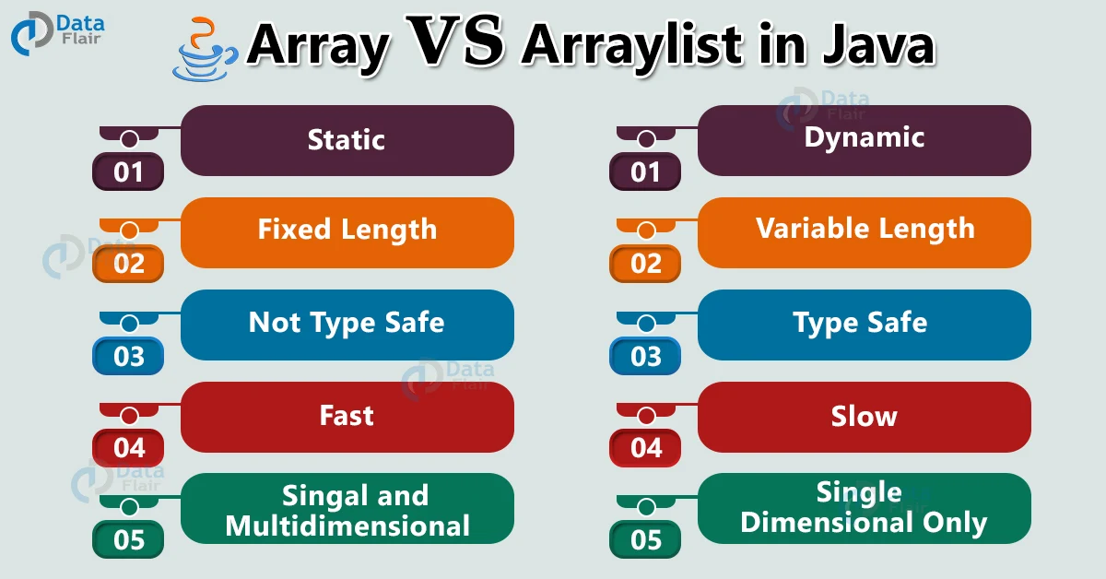
Difference between array and arraylist

Slide 175
LinkedList
LinkedList implements the Collection interface. It uses a doubly linked list internally to store the elements.
It can store the duplicate elements.
It maintains the insertion order and is not synchronized.
In LinkedList, the manipulation is fast because no shifting is required.
Java LinkedList class can be used as a list, stack or queue.

Slide 176
Syntax for LinkedList
LinkedList <Object> Variable = new LinkedList <Object> ();

Slide 177
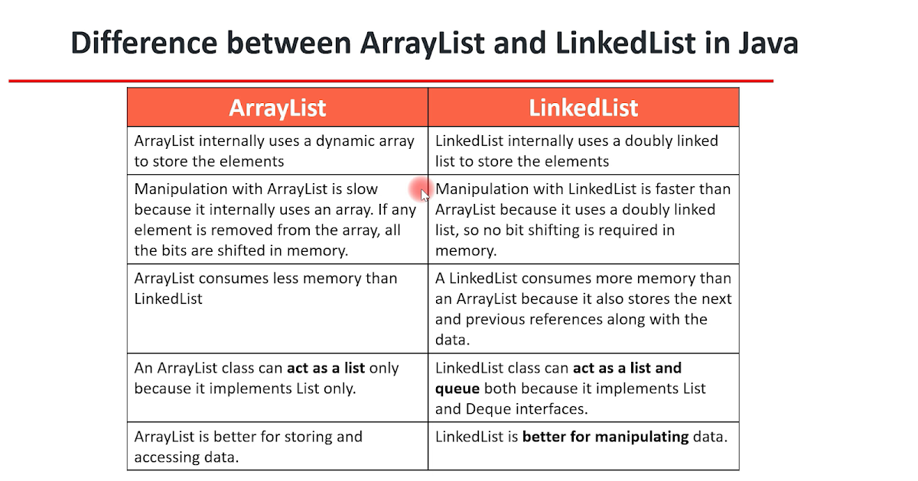

Slide 178
Set in Java
A Set is a Collection that cannot contain duplicate elements. It models the mathematical set abstraction.
The Set interface contains only methods inherited from Collection and adds the restriction that duplicate elements are prohibited.
Types of set
HashSet
TreeSet

Slide 179
Hash Set
HashSet stores the elements by using a mechanism called hashing.
HashSet contains unique elements only.
HashSet allows null value.
HashSet class is non synchronized.
HashSet doesn't maintain the insertion order. Here, elements are inserted on the basis of their hashcode.
HashSet is the best approach for search operations.
The initial default capacity of HashSet is 16, and the load factor is 0.75.

Slide 180
Syntax for HashSet
HashSet<Object> Variable =new HashSet<Object> ();

Slide 181
Spliterator
Spliterator<String> numbers = l.spliterator();
System.out.println("list of ele:");
numbers.forEachRemaining((n) -> System.out.println(n));
System.out.println();
Iterator
Iterator i=l.iterator();
while(i.hasNext())
{
System.out.println(i.next());
}

Slide 182
Tree Set
TreeSet class contains unique elements only like HashSet.
TreeSet class access and retrieval times are quiet fast.
TreeSet class doesn't allow null element.
TreeSet class is non synchronized.
TreeSet class maintains ascending order.

Slide 183
Syntax for TreeSet
Treeset <Object> Variable =new Treeset <Object> ();

Slide 184
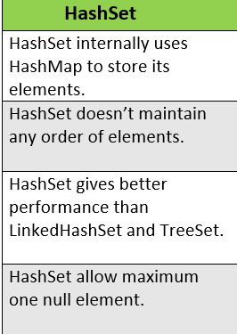
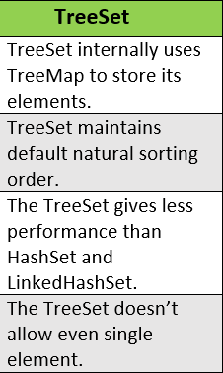
Difference between hashset and treeset

Slide 185
HashMap
Java HashMap contains values based on the key.
Java HashMap contains only unique keys.
Java HashMap may have one null key and multiple null values.
Java HashMap is non synchronized.
Java HashMap maintains no order.
The initial default capacity of Java HashMap class is 16 with a load factor of 0.75.

Slide 186
Syntax for HashMap
HashMap <Object,Object> Variable =
new HashMap <Object,Object> ();

Slide 187
for(Map.Entry<Integer, String> v: h.entrySet())
{
System.out.println(v);
}
h.compute(4,(key,val)->val.concat("jana"));
System.out.println(h);
h.computeIfPresent(5,(key,val)->val+("janarthanan"));
System.out.println(h);
h.computeIfAbsent(7,k-> "keerthi"+"Pooja");

Slide 188
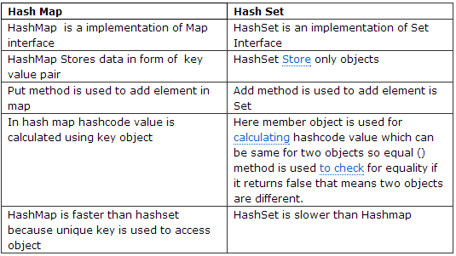
Difference Between Hashmap and Hashset

Slide 189
Treemap
Java TreeMap contains only unique elements.
Java TreeMap cannot have a null key but can have multiple null values.
Java TreeMap is non synchronized.
Java TreeMap maintains ascending order.

Slide 190
Syntax for TreeMap
TreeMap <Object,Object> Variable =
new TreeMap <Object,Object> ();

Slide 191
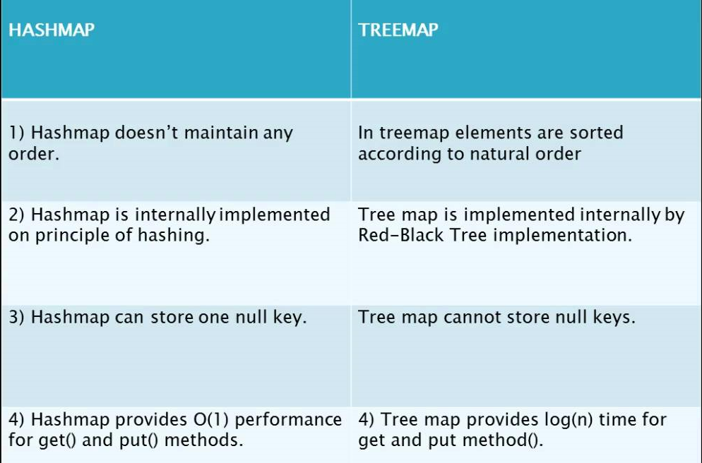
Difference between HashMap and TreeMap

Slide 192
Stack in java
The stack is a linear data structure that is used to store the collection of objects. It is based on Last-In-First-Out (LIFO).
One of them is the Stack class that provides different operations such as push, pop, search, etc.
The stack data structure has the two most important operations that are push and pop.
The push operation inserts an element into the stack and pop operation removes an element from the top of the stack.

Slide 193
Queue in java
It is used to keep the elements that are processed in the First In First Out (FIFO) manner.
It is an ordered list of objects, where insertion of elements occurs at the end of the list, and removal of elements occur at the beginning of the list.
Types of Queue
PriorityQueue
Dequeue

Slide 194
PriorityQueue
PriorityQueue is also class that is defined in the collection framework that gives us a way for processing the objects on the basis of priority.
It is already described that the insertion and deletion of objects follows FIFO pattern in the Java queue.
However, sometimes the elements of the queue are needed to be processed according to the priority, that's where a PriorityQueue comes into action.

Slide 195
Syntax for PriorityQueue
PriorityQueue<Object> Variable=new PriorityQueue<Object>();

Slide 196
Dequeue
The interface called Deque is present in java.util package. It is the subtype of the interface queue.
The Deque supports the addition as well as the removal of elements from both ends of the data structure.
As a deque supports both, either of the mentioned operations can be performed on it. Deque is an acronym for "double ended queue".

Slide 197
Syntax for Dequeue
Dequeue<Object> Variable= new Dequeue<Object> ();

Slide 198
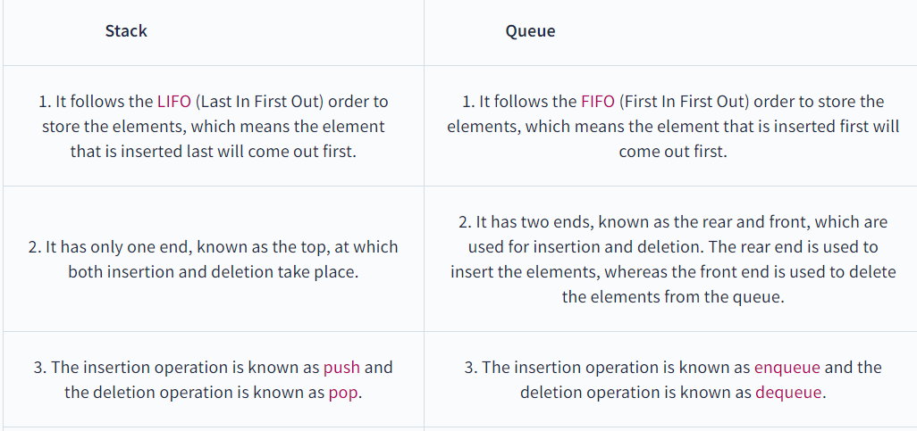
Stack vs Queue

Slide 199
THREAD AND MULTITHREAD

Slide 200
Thread
A thread is a thread of execution in a program.
The Java Virtual Machine allows an application to have multiple threads of execution running concurrently.
Every thread has a priority . Threads with higher priority are executed in preference to threads with lower priority.
A thread is also known as a lightweight processor execution context.

Slide 201
Types of Thread
Single Thread
Multi Thread
Priority Thread
Daemon Thread
Synchronization
Garbage Collection

Slide 202
Single Thread
A single thread in Java is basically a lightweight and the smallest unit of processing.
Java uses threads by using a “Thread Class”.

Slide 203
How to create a single thread in Java?
You can create threads by implementing the runnable interface and overriding the run() method.
Then, you can create a thread object and call the start() method.
Thread Class: The Thread class provides constructors and methods for creating and operating on threads.

Slide 204
Multithread
In Java, Multithreading refers to a process of executing two or more threads simultaneously for maximum utilization of the CPU.
we use multithreading than multiprocessing because threads use a shared memory area.
They don't allocate separate memory area so saves memory, and context-switching between the threads takes less time than process.
Java Multithreading is mostly used in games, animation, etc.

Slide 205
Advantages of Java Multithreading
1) It doesn't block the user because threads are independent and you can perform multiple operations at the same time.
2) You can perform many operations together, so it saves time.
3) Threads are independent, so it doesn't affect other threads if an exception occurs in a single thread.

Slide 206
Threads can be created by using two mechanisms :
Extending the Thread class
Implementing the Runnable Interface

Slide 207
Java Runnable Interface
Java runnable is an interface used to execute code on a concurrent thread.
It is an interface which is implemented by any class if we want that the instances of that class should be executed by a thread.

Slide 208
public void run()
This method takes in no arguments.
When the object of a class implementing Runnable class is used to create a thread.
Then the run method is invoked in the thread which executes separately.

Slide 209
How to create a thread using Runnable interface
Runnable runnable = new MyRunnable();
Thread thread = new Thread(runnable);
thread.start();
The thread will execute the code which is mentioned in the run() method of the Runnable object passed in its argument.

Slide 210
A simple thread example using runnable
public class ExampleClass implements Runnable {
public void run() {
System.out.println("Thread has ended");
}
public static void main(String[] args) {
ExampleClass ex = new ExampleClass();
Thread t1= new Thread(ex);
t1.start();
System.out.println("Hi");
}
}

Slide 211
Thread creation by extending the Thread class
We create a class that extends the java.lang.Thread class. This class overrides the run() method available in the Thread class.
A thread begins its life inside run() method.
We create an object of our new class and call start() method to start the execution of a thread.
Start() invokes the run() method on the Thread object.

Slide 212
Example program
class Multi extends Thread
{
public void run(){
System.out.println("thread is running...");
}
public static void main(String args[])
{
Multi t1=new Multi();
t1.start();
}

Slide 213
Daemon Thread
Daemon thread in Java is a service provider thread that provides services to the user thread.
when all the user threads dies, JVM terminates this thread automatically.
It provides services to user threads for background supporting tasks. It has no role in life than to serve user threads.
Its life depends on user threads.
It is a low priority thread.

Slide 214
Why JVM terminates the daemon thread if there is no user thread?
The sole purpose of the daemon thread is that it provides services to user thread for background supporting task.
If there is no user thread, why should JVM keep running this thread.
That is why JVM terminates the daemon thread if there is no user thread.

Slide 215
Example
public class TestDaemonThread1 extends Thread{
public void run(){
if(Thread.currentThread().isDaemon()){//checking for daemon thread
System.out.println("daemon thread work");
} else{
System.out.println("user thread work");
} }
public static void main(String[] args){
TestDaemonThread1 t1=new TestDaemonThread1();//creating thread
TestDaemonThread1 t2=new TestDaemonThread1();
TestDaemonThread1 t3=new TestDaemonThread1();
t1.setDaemon(true);
t1.start();
t2.start();
t3.start();
} }

Slide 216
Priority of a Thread
Each thread has a priority. Priorities are represented by a number between 1 and 10.
In most cases, the thread scheduler schedules the threads according to their priority (known as preemptive scheduling).
But it is not guaranteed because it depends on JVM specification that which scheduling it chooses.

Slide 217
Setter & Getter Method of Thread Priority
public final int getPriority(): The java.lang.Thread.getPriority() method returns the priority of the given thread.
public final void setPriority(int newPriority): The java.lang.Thread.setPriority() method updates or assign the priority of the thread to newPriority.
The method throws IllegalArgumentException if the value newPriority goes out of the range, which is 1 (minimum) to 10 (maximum).

Slide 218
Example of priority of a Thread:
import java.lang.*;
public class ThreadPriorityExample extends Thread {
public void run() {
System.out.println("Inside the run() method"); }
public static void main(String argvs[]) {
ThreadPriorityExample th1 = new ThreadPriorityExample();
ThreadPriorityExample th2 = new ThreadPriorityExample();
ThreadPriorityExample th3 = new ThreadPriorityExample();
System.out.println("Priority of the thread th1 is : " + th1.getPriority());
System.out.println("Priority of the thread th2 is : " + th2.getPriority());
System.out.println("Priority of the thread th2 is : " + th2.getPriority());
th1.setPriority(6);
th2.setPriority(3);
th3.setPriority(9);

Slide 219
System.out.println("Priority of the thread th1 is : " + th1.getPriority());
System.out.println("Priority of the thread th2 is : " + th2.getPriority());
System.out.println("Priority of the thread th3 is : " + th3.getPriority());
System.out.println("Currently Executing The Thread : " + Thread.currentThread().getName());
System.out.println("Priority of the main thread is : " + Thread.currentThread().getPriority());
Thread.currentThread().setPriority(10);
System.out.println("Priority of the main thread is : " + Thread.currentThread().getPriority());
}
}

Slide 220
Synchronization
Synchronization in Java is the capability to control the access of multiple threads to any shared resource.
Java Synchronization is better option where we want to allow only one thread to access the shared resource.

Slide 221
Why use Synchronization?
The synchronization is mainly used to
To prevent thread interference.
To prevent consistency problem.

Slide 222
Java Synchronized Method
If you declare any method as synchronized, it is known as synchronized method.
Synchronized method is used to lock an object for any shared resource.
When a thread invokes a synchronized method, it automatically acquires the lock for that object and releases it when the thread completes its task.

Slide 223
Example
class Table{
void printTable(int n){//method not synchronized
for(int i=1;i<=5;i++){
System.out.println(n*i);
try{ Thread.sleep(400);
}catch(Exception e){System.out.println(e);} } } }
class MyThread1 extends Thread{
Table t;
MyThread2(Table t){ this.t=t; }
public void run(){ t.printTable(50); } }

Slide 224
class MyThread2 extends Thread{
Table t;
MyThread2(Table t){ this.t=t; }
public void run(){ t.printTable(100); } }
class TestSynchronization1{
public static void main(String args[]){
Table obj = new Table();//only one object
MyThread1 t1=new MyThread1(obj);
MyThread2 t2=new MyThread2(obj);
t1.start();
t2.start(); } }

Slide 225
Thread join method
The join() method in Java is provided by the java.lang.Thread class that permits one thread to wait until the other thread to finish its execution.
When there are more than one thread invoking the join() method, then it leads to overloading on the join() method that permits the developer or programmer to mention the waiting period.

Slide 226
Example
class TestJoinMethod1 extends Thread{
public void run(){
for(int i=1;i<=5;i++){
try{
Thread.sleep(500);
}catch(Exception e){System.out.println(e);}
System.out.println(i);
} }

Slide 227
public static void main(String args[]){
TestJoinMethod1 t1=new TestJoinMethod1();
TestJoinMethod1 t2=new TestJoinMethod1();
TestJoinMethod1 t3=new TestJoinMethod1();
t1.start();
try{ t1.join();
}catch(Exception e){System.out.println(e);}
t2.start();
t3.start(); } }

Slide 228
Garbage Collection
garbage means unreferenced objects.
Garbage Collection is process of reclaiming the runtime unused memory automatically. In other words, it is a way to destroy the unused objects.
To do so, we were using free() function in C language and delete() in C++. But, in java it is performed automatically. So, java provides better memory management.

Slide 229
Advantage of Garbage Collection
It makes java memory efficient because garbage collector removes the unreferenced objects from heap memory.
It is automatically done by the garbage collector(a part of JVM) so we don't need to make extra efforts.

Slide 230
How can an object be unreferenced?
There are many ways:
By nulling the reference
By assigning a reference to another
By anonymous object etc.

Slide 231
By nulling a reference:
Employee e=new Employee();
e=null;
By assigning a reference to another:
Employee e1=new Employee();
Employee e2=new Employee();
e1=e2;
By anonymous object:
new Employee();

Slide 232
finalize() method
The finalize() method is invoked each time before the object is garbage collected.
This method can be used to perform cleanup processing.
This method is defined in Object class as:
protected void finalize(){}

Slide 233
gc() method
The gc() method is used to invoke the garbage collector to perform cleanup processing.
The gc() is found in System and Runtime classes.
public static void gc(){}

Slide 234
Simple Example of garbage collection in java
public class TestGarbage1{
public void finalize(){System.out.println("object is garbage collected");}
public static void main(String args[]){
TestGarbage1 s1=new TestGarbage1();
TestGarbage1 s2=new TestGarbage1();
s1=null;
s2=null;
System.gc();
} }

Slide 235
Database Management
Introduction and JDBC

Slide 236
Database
A database is an organized collection of data, so that it can be easily accessed and managed.
The main purpose of the database is to operate a large amount of information by storing, retrieving, and managing data.
SQL or Structured Query Language is used to operate on the data stored in a database.

Slide 237
JDBC(Java Data Base Connectivity )
It is used to connect Front end and Back end.
To connect client and server.
How to connect java program to mysql connector.
Package -- build path – configure build path – libraries –modulepath –
Add external JARs – set the mysql connector – apply to all – close.
After apply Reference library will be added.

Slide 238
Front end
Java
Python
Html
Dot net
C++
Back end
Mysql
Sql
Mongo DB
Oracal

Slide 239
Syntax for SQL
CREATE DATABASE DATABASE NAME;
CREATE TABLE TABLENAME(ID INT,NAME VARCHAR(25),MARK INT);
INSERT INTO (TABLE NAME) VALUES(12,”KOKILA”,100);
DELETE FROM (TABLE NAME) WHERE ID=12;
UPDATE (TABLE NAME) SET NAME=“”,MARK=“”,WHERE ID=12;

Slide 240
6. TO VIEW THE TABLE
SELECT * FROM(TABLE NAME);
TO ACCESS COLOUM WISE
SELECT NAME FROM (TABLE NAME);
8. TO ACCESS ROW WISE
SELECT * FROM (TABLE NAME) WHERE NAME ="SASIKUMAR";
9. TO DELETE COLUMN
ALTER TABLE (TABLENAME) DROP COLUMN COLUMN NAME ;
TO ADD COLUMN
ALTER TABLE (TABLENAME) ADD COLUMN COLUMN NAME ;

Slide 241
Connection interface
A Connection is a session between a Java application and a database. It helps to establish a connection with the database.
The Connection interface is a factory of Statement, PreparedStatement.

Slide 242
DriverManager
The DriverManager class is the component of JDBC API and also a member of the java.sql package.
The DriverManager class acts as an interface between users and drivers.

Slide 243
PreparedStatement
An object that represents a precompiled SQL statement.
A SQL statement is precompiled and stored in a PreparedStatement object.
This object can then be used to efficiently execute this statement multiple times.

Slide 244
String url="jdbc:mysql://localhost/swing_demo";
String user="root";
String password="";
try {
Connection c=DriverManager.getConnection(url,user,password);
PreparedStatement ps= c.prepareStatement("Insert into student values(?,?,?)");
ps.setInt(1, 1);
ps.setString(2,"kokila");
ps.setString(3, "12364597");
//ps.setInt(1, 7);
ps.execute();
System.out.println("success");
} catch (SQLException e)
{
e.printStackTrace();
}

Slide 245
Serialization and Deserialization

Slide 246
What is Serialization and deserialization?
Serialization in Java is a mechanism of writing the state of an object into a byte-stream.
The reverse operation of serialization is called deserialization where byte-stream is converted into an object.

Slide 247
The serialization and deserialization process is platform-independent.
it means you can serialize an object on one platform and deserialize it on a different platform.

Slide 248
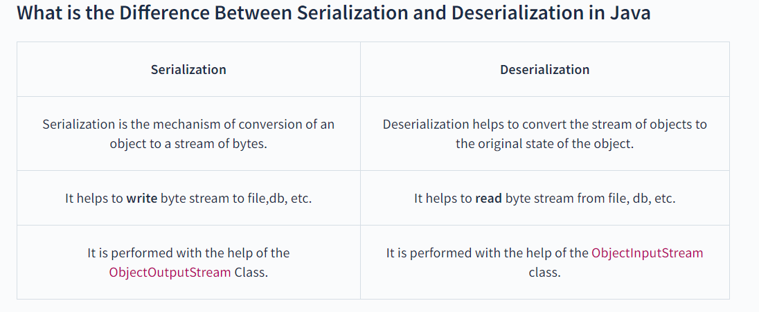

Slide 249
java.io.Serializable interface
The Serializable interface must be implemented by the class whose object needs to be persisted.
The String class and all the wrapper classes implement the java.io.Serializable interface by default.

Slide 250
Example:
import java.io.Serializable;
public class Student implements Serializable{
int id;
String name;
public Student(int id, String name) {
this.id = id;
this.name = name;
}
}

Slide 251
Serialization program:
import java.io.*;
class Persist{
public static void main(String args[]){
try{
Student s1 =new Student(211,"ravi");
FileOutputStream fout=new FileOutputStream("f.txt");
ObjectOutputStream out=new ObjectOutputStream(fout);
out.writeObject(s1);
out.flush();
out.close();
System.out.println("success");
}catch(Exception e){System.out.println(e);}
}
}

Slide 252
Deserialization:
import java.io.*;
class Depersist{
public static void main(String args[]){
try{
ObjectInputStream in=new ObjectInputStream(new FileInputStream("f.txt")); Student s=(Student)in.readObject();
System.out.println(s.id+" "+s.name);
in.close();
}catch(Exception e){System.out.println(e);}
}
}

Slide 253
Networking in Java

Slide 254
What is Networking?
Java Networking is a concept of connecting two or more computing devices together so that we can share resources.
Java socket programming provides facility to share data between different computing devices.
Networking in java is possible through the use of java.net package.

Slide 255
Advantage of Java Networking
Sharing resources
Centralize software management
Centralized network management refers to managing a network built around a single server.

Slide 256
Java Networking Terminology
IP Address
IP address is a unique number assigned to a node of a network
It is a logical address that can be changed.
By using command prompt using this comment to know the IP address of the system.
ipconfig

Slide 257
2. Port Number
The port number is associated with the IP address for communication between two applications.
The port number is used to uniquely identify different applications.
Total ports 65536
Reserved ports 20000
Port –20 is File transfer protocol(FTP)
Port –25 is Simple Mail Transfer Protocol(SMTP)

Slide 258
3. Protocol
A protocol is a set of rules basically that is followed for communication.
For example:
TCP
UDP
FTP
Telnet
SMTP
POP etc.

Slide 259
Java socket programming
Java Socket programming is used for communication between the applications running on different JRE.
Java Socket programming can be connection-oriented or connection-less.
Socket and ServerSocket classes are used for connection-oriented socket programming

Slide 260
The client in socket programming must know two information:
IP Address of Server, and
Port number.
Here, two classes are being used: Socket and ServerSocket
The Socket class is used to communicate client and server.
The ServerSocket class is used at server-side.
The accept() method of ServerSocket class blocks the console until the client is connected.

Slide 261
import java.io.*;
import java.net.*; //Server side programming
public class MyServer {
public static void main(String[] args){
try{
ServerSocket ss=new ServerSocket(6666);
Socket s=ss.accept();
DataInputStream dis=new DataInputStream(s.getInputStream());
String str=(String)dis.readUTF();
System.out.println("message= "+str);
ss.close();
}catch(Exception e){System.out.println(e);}
}
}

Slide 262
import java.io.*;
import java.net.*; //Client side programming
public class MyClient {
public static void main(String[] args) {
try{
Socket s=new Socket("localhost",6666);
DataOutputStream dout=new DataOutputStream(s.getOutputStream());
dout.writeUTF("Hello Server");
dout.flush();
dout.close();
s.close();
}catch(Exception e){System.out.println(e);}
}
}

Slide 263
Java Swings
Event Handling and Layout Managers

Slide 264
Java Swing
Swing in java is part of Java foundation class which is lightweight and platform independent.
It is used for creating window based applications. It includes components like button, scroll bar, text field etc.
Putting together all these components makes a graphical user interface.

Slide 265
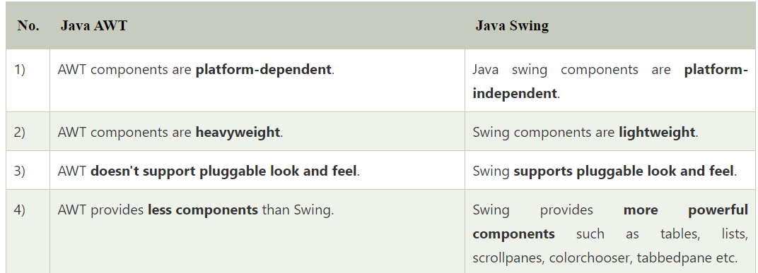

Slide 266
GUI
A graphics-based operating system interface that uses icons, menus and a mouse (to click on the icon or pull down the menus) to manage interaction with the system.
GUIs help your users do things within your device, platform, program, or app without needing to type commands or know the coding behind the action.

Slide 267
Every application is a collection of program.
But , here we will call collection of windows , like JFrame
JFrame is a class in javax.swing package.
By using this we can create ,
Gamming apps
Billing System
Calculator
Calander

Slide 268
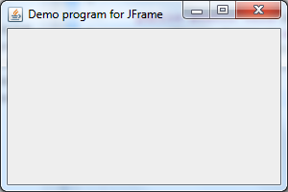
Methods in java swings
JFrame
f=new JFrame();
f.setContentPane(new JLabel(new ImageIcon("C:\\Users\\manojana\\OneDrive\\Pictures\\Saved Pictures\\b1.jpg")));
f.setSize(600,600);
f.setLayout(null);
f.setVisible(true);

Slide 269
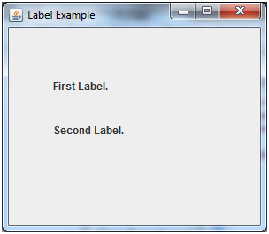
JLabel
l1=new JLabel("welcome to JMSMK TRAVELS");
l1.setBounds(350, 20, 500, 50);
l1.setFont(new Font("Times new roman",Font.ITALIC,40));
l1.setForeground(Color.black);
f.add(l1);

Slide 270
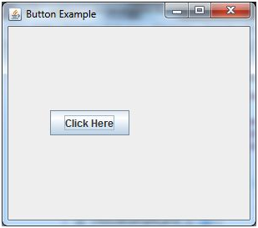
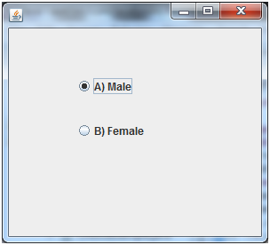
JButton
b13=new JButton("Book");
b13.setBounds(400, 485, 80, 60);
b13.setFont(new Font("Times new roman",Font.ITALIC,20));
f.add(b13);
Radio Button
male = new JRadioButton("Male");
male.setFont(new Font("Arial", Font.PLAIN, 15));
male.setSelected(true);
male.setBounds(820, 200, 60, 60);
f.add(male);

Slide 271
Radio Button
female = new JRadioButton("Female");
female.setFont(new Font("Arial", Font.PLAIN, 15));
female.setSelected(false);
female.setBounds(720, 190, 100, 80);
f.add(female);
Using radio button we use button group to add radio buttons.
gengp = new ButtonGroup();
gengp.add(male);
gengp.add(female);

Slide 272
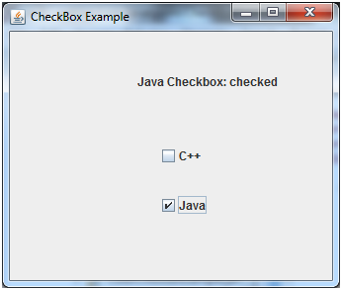
JCheckBox
term = new JCheckBox("Accept Terms And Conditions.");
term.setFont(new Font("Arial", Font.ITALIC, 15));
term.setBounds(400, 435, 300, 50);
f.add(term);

Slide 273
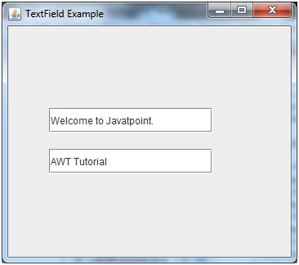
JTextField
t1=new JTextField();
t1.setFont(new Font("Times new roman",Font.ITALIC,30));
t1.setBounds(300, 100,200,50);
f.add(t1);

Slide 274
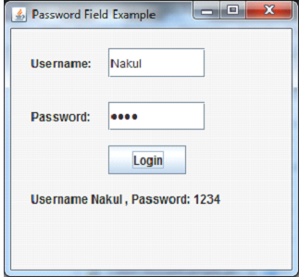
Password Field
ps=new JPasswordField();
ps.setFont(new Font("algerian",Font.BOLD,20));
ps.setBounds(250,220, 150, 50);
f.add(ps);

Slide 275
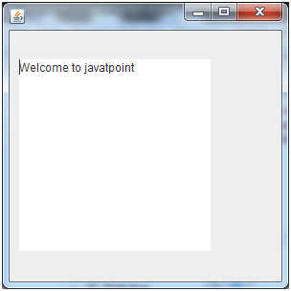
JTextArea
TA = new JTextArea();
TA.setFont(new Font("Times new roman",Font.ITALIC,30));
TA.setBounds(800, 345, 500, 400);
TA.setBackground(Color.GREEN);
TA.setLineWrap(false);
f.add(TA);

Slide 276
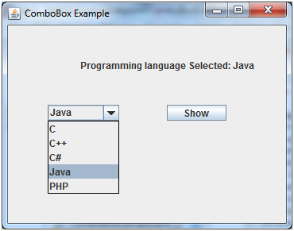
JComboBox
String months[]
= { "July", "Aug",
"Sup", "Oct", "Nov", "Dec" ,
"Jan", "feb", "Mar", "Apr",
"May", "Jun"};
cb3 = new JComboBox(months);
cb3.setFont(new Font("Arial", Font.PLAIN, 15));
cb3.setBounds(470, 350, 60, 60);
f.add(cb3);

Slide 277
Simple Java Swing Example
public class FirstSwingExample {
public static void main(String[] args) {
JFrame f=new JFrame();//creating instance of JFrame
JButton b=new JButton("click");//creating instance of JButton
b.setBounds(130,100,100, 40);//x axis, y axis, width, height
f.add(b);//adding button in JFrame
f.setSize(400,500);//400 width and 500 height
f.setLayout(null);//using no layout managers
f.setVisible(true);//making the frame visible
}
}

Slide 278
Event Handling
Changing the state of an object is known as an event.
For example, click on button, dragging mouse etc.
The java.awt.event package provides many event classes and Listener interfaces for event handling.

Slide 279
Steps to perform Event Handling
Following steps are required to perform event handling:
Register the component with the Listener

Slide 280
Registration Methods
For registering the component with the Listener, many classes provide the registration methods. For example:
Button
  public void addActionListener(ActionListener a){}
TextField
  public void addActionListener(ActionListener a){}

Slide 281
Java event handling by implementing ActionListener
import java.awt.*;
import java.awt.event.*;
class AEvent extends Frame implements ActionListener{
TextField tf;
AEvent(){
tf=new TextField();
tf.setBounds(60,50,170,20);
Button b=new Button("click me");
b.setBounds(100,120,80,30);
b.addActionListener(this);//passing current instance
add(b);add(tf);

Slide 282
setSize(300,300);
setLayout(null);
setVisible(true); }
public void actionPerformed(ActionEvent e){
tf.setText("Welcome");
}
public static void main(String args[]){
new AEvent();
}
}

Slide 283
Layout Managers
The LayoutManagers are used to arrange components in a particular manner.
The Java LayoutManagers facilitates us to control the positioning and size of the components in GUI forms.
LayoutManager is an interface that is implemented by all the classes of layout managers.

Slide 284
There are the following classes that represent the layout managers:
java.awt.BorderLayout
java.awt.FlowLayout
java.awt.GridLayout
java.awt.CardLayout
java.awt.GridBagLayout
javax.swing.BoxLayout
javax.swing.GroupLayout
javax.swing.ScrollPaneLayout
javax.swing.SpringLayout etc.

Slide 285
Java BorderLayout
The BorderLayout is used to arrange the components in five regions: north, south, east, west, and center.
Each region (area) may contain one component only. It is the default layout of a frame or window.

Slide 286
The BorderLayout provides five constants for each region:
public static final int NORTH
public static final int SOUTH
public static final int EAST
public static final int WEST
public static final int CENTER

Slide 287
Constructors of BorderLayout class:
BorderLayout(): creates a border layout but with no gaps between the components.
BorderLayout(int hgap, int vgap): creates a border layout with the given horizontal and vertical gaps between the components.

Slide 288
Example of BorderLayout class: Using BorderLayout(int hgap, int vgap) constructor
import java.awt.*;
import javax.swing.*;
public class BorderLayoutExample
{
JFrame jframe;
BorderLayoutExample()
{
jframe = new JFrame();
JButton btn1 = new JButton("NORTH");
JButton btn2 = new JButton("SOUTH");
JButton btn3 = new JButton("EAST");
JButton btn4 = new JButton("WEST");
JButton btn5 = new JButton("CENTER");

Slide 289
jframe.setLayout(new BorderLayout(20, 15));
jframe.add(btn1, BorderLayout.NORTH);
jframe.add(btn2, BorderLayout.SOUTH);
jframe.add(btn3, BorderLayout.EAST);
jframe.add(btn4, BorderLayout.WEST);
jframe.add(btn5, BorderLayout.CENTER);
jframe.setSize(300,300);
jframe.setVisible(true);
}
public static void main(String argvs[])
{
new BorderLayoutExample();
}
}

Slide 290
Internationalization and Localization in Java
Internationalization is also abbreviated as I18N because there are total 18 characters between the first letter 'I' and the last letter 'N’.
Internationalization is one of the powerful concept of java if you are developing an application and want to display messages, currencies, date, time etc. according to the specific region or language.

Slide 291
Localization
Localization is also abbreviated as I10N because there are total 10 characters between the first letter 'L' and last letter 'N’.
Localization is the mechanism to create such an application that can be adapted to a specific language and region by adding locale-specific text and component.

Slide 292
Example for Localization
import java.util.*;
public class LocaleExample {
public static void main(String[] args) {
Locale locale=Locale.getDefault();
System.out.println(locale.getDisplayCountry());
System.out.println(locale.getDisplayLanguage());
System.out.println(locale.getDisplayName());
System.out.println(locale.getLanguage());
System.out.println(locale.getCountry());
}
}

Slide 293
Example of Internationalization
import java.util.*;
public class LocaleExample2 {
public static void main(String[] args) {
Locale enLocale = new Locale("en", "US");
Locale frLocale = new Locale("fr", "FR");
Locale esLocale = new Locale("es", "ES");
System.out.println("English language name (default): " +
enLocale.getDisplayLanguage());
System.out.println("English language name in French: " +
enLocale.getDisplayLanguage(frLocale));
System.out.println("English language name in spanish: " +
enLocale.getDisplayLanguage(esLocale));
}
}

